Slide 1
K Nearest Neighbor
Classification Algorithm

Slide 2

It was raining heavily since last 7 days. There will be a seminar in my college tomorrow. I’m trying to predict that tomorrow will be a rainy day or not?
Day 1 | Rain
Day 2 | Rain
Day 3 | Rain
Day 4 | Rain
Day 5 | Rain
Day 6 | Rain
Day 7 | Rain
Day 8 | ?

Slide 3
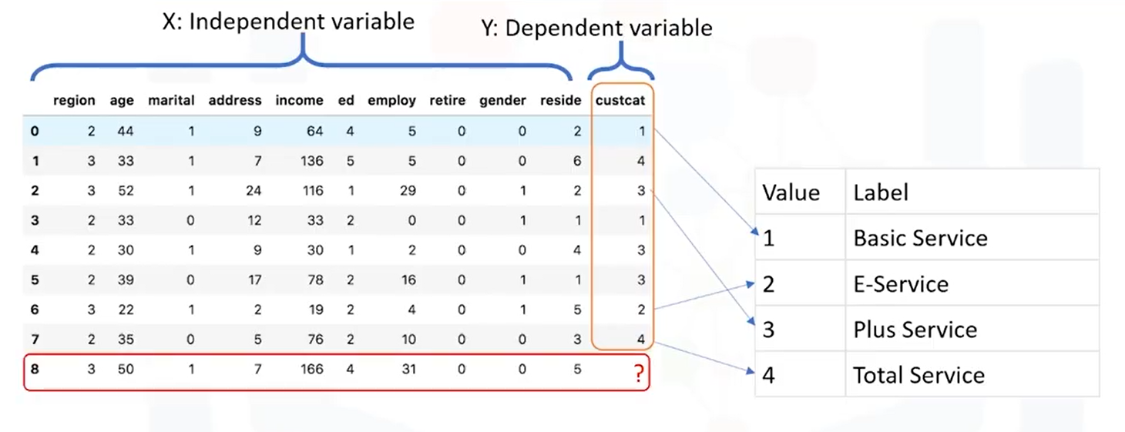
KNN: Used the bunch of data just to label the new data

Slide 4
KNN: Used the bunch of data just to label the new data

Slide 5
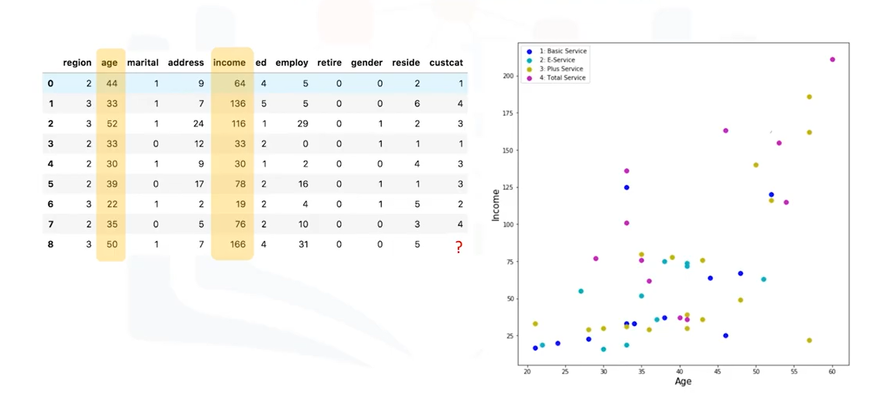
Determining the class using 1st KNN:

Slide 6
Determining the class using 1st KNN:

Slide 7
Determining the class using 1st KNN:

Slide 8
Determining the class using 1st KNN:
?

Slide 9
Determining the class using 1st KNN:
?
1 – NN: Total Service

Slide 10
Determining the class using 5 KNNs:
?

Slide 11
Determining the class using 5 KNNs:
?

Slide 12
Determining the class using 5 KNNs:
?
5 NNs: Plus Service

Slide 13
How does KNN works?
Pick a value of K
Calculate the distance of unknown cases from all cases(similarity distance)
Select the K- Observations in the training data that are “nearest” to the unknown data points
Predict the response of the unknown data point using the most popular response value from the K – nearest neighbors

Slide 14
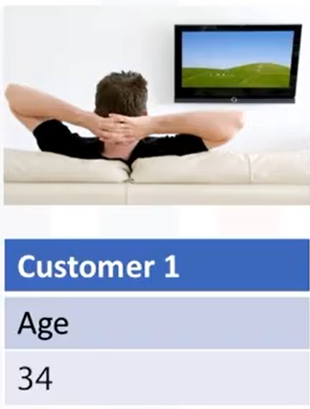
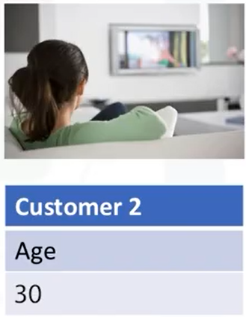
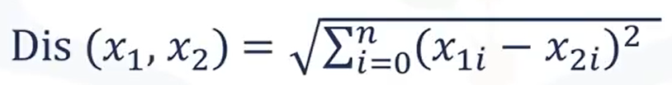
Calculating similarity distance:

Slide 15

Calculating similarity distance:
….Euclidean distance

Slide 16
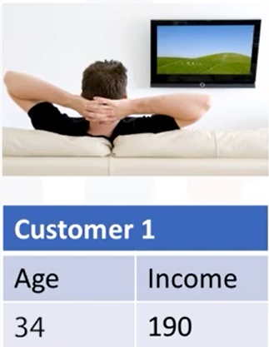
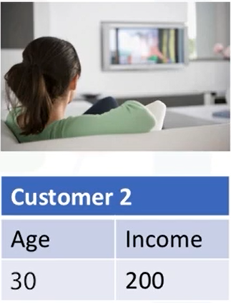
Calculating similarity distance:
If the data having more than one feature:
….Euclidean distance

Slide 17
Calculating similarity distance:
If the data having more than one feature:
….Euclidean distance

Slide 18
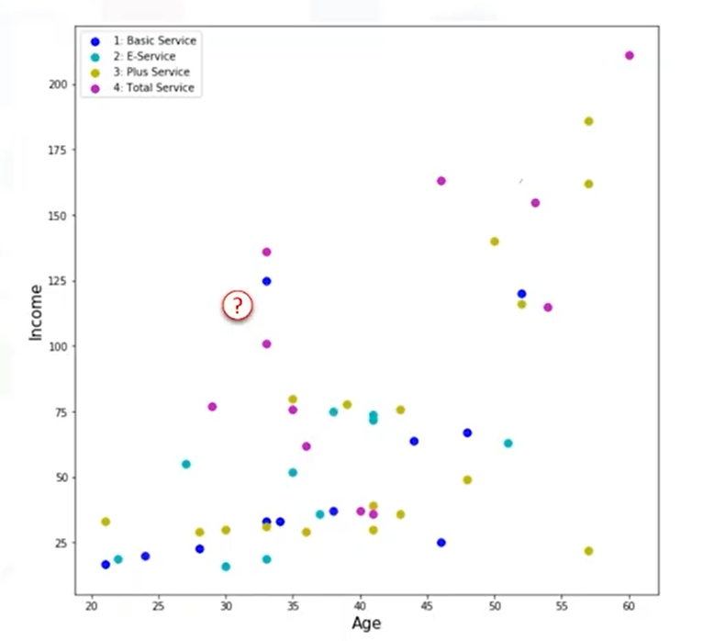
What is the best value of K?

Slide 19
What is the best value of K?
K=1

Slide 20
What is the best value of K?
K=1
Class 1: Basic Service

Slide 21
What is the best value of K?
K=1
Class 1: Basic Service

Slide 22
What is the best value of K?
K=1
Class 1: Basic Service

Slide 23
What is the best value of K?
…Low Value
K=1
Class 1: Basic Service

Slide 24
What is the best value of K?
…Low Value
K=1
K=20 …High Value

Slide 25
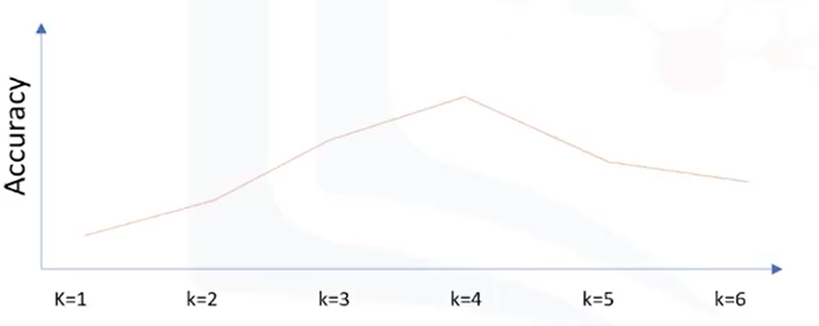
What is the best value of K?
…Low Value
K=1
K=20 …High Value

Slide 26
Evaluation Metrics in Classification

